Slide 1
Approaches
Skill based learning (Sept 2020)

Slide 2
Task one
Compare your 6 mark response with the information provided on the next slide

Slide 3
Describe and evaluate the behaviourist approach (16)
AO1: The behaviourist approach believes that human behaviour can be explained in terms of learning, known as conditioning, which includes classical and operant conditioning.
AO1: In Pavlov’s original experiment with dogs, he continually presented a bell (neutral stimulus) with food (unconditioned stimulus), which caused the dog to salivate (unconditioned response). Eventually, the dog associated the sound of the bell and the food, so that sound of the bell (now a conditioned stimulus) would cause the dog to salivate (conditioned response). Pavlov’s experiment demonstrates the learning of innate reflex behaviours in animals.
AO1: Operant conditioning explains the learning of voluntary behaviour through positive and negative reinforcement. Positive reinforcement occurs when a behaviour produces a consequence that is rewarding, whereas negative reinforcement occurs when a behaviour removes an unpleasant consequence. Both positive and negative reinforcement make a behaviour more likely to occur again.

Slide 4
Task 2
Read through the following slides to see how you could structure the A03 section of a 16 mark response.
Remember there are 10 marks available for A03
We have suggested 3 ‘burger scaffolds’ which provide you with the relevant P. E.E

Slide 5
AO3
POINT - One strength of the behaviourist approach is its application to the treatment of phobias.
EVIDENCE - Classical conditioning has led to the development of systematic desensitisation – a treatment which reduces the anxiety associated with phobias.
EXPLAIN - This matters because…systematic desensitisation is an effective treatment for a range of phobias and demonstrates the utility of the behaviourist approach, to help improve the lives of people with phobias.

Slide 6
AO3
POINT - Another strength of the behaviourist approach comes from research by Watson & Raynor.
EVIDENCE - They demonstrated the process of classical conditioning in Little Albert, who was conditioned to fear white rats. They did this by striking a steal bar behind Little Albert’s head, every time Little Albert reached for the white rat (neutral stimulus). Eventually, Little Albert formed an association so that the rat become a conditioned stimulus which produced fear (conditioned response).
EXPLAIN - This matters because…it supports the idea that classical conditioning is involved in the learning of innate reflex behaviour – in this case phobias.

Slide 7
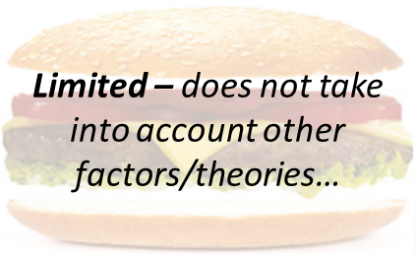
AO3
POINT - However, one criticism of the behaviourist approach is that it does not take into account other factors, for example, cognitions.
EVIDENCE - The behaviourist approach ignores the role of cognition (thinking) in the learning of behaviour and suggests that only behaviour which can be directly observed, should be measured. However, cognitive psychologists believe that internal mental processes can be studied scientifically.
EXPLAIN - This matters because…the behaviourist approach does not provide a complete explanation of human behaviour and ignore other factors (e.g. cognition) which may play an important role in some behaviours. Therefore, the behaviourist approach is limited in its application to human behaviour.

Slide 8
Over to you…
Have a go at completing the cognitive approach question
Describe and evaluate the cognitive approach
Some guidance has been provided
Use the ‘burger scaffold’ P. E. E
Without looking at your notes draw a spider diagram with everything you can remember about the cognitive approach, use different colours to distinguish between the A01 (describe) and A03 (evaluate)
Cognitive approach

Slide 9
DESCRIBE AND EVALUATE THE COGNITIVE APPROACH (16)
Hopefully you will recognise that you have the following on your spider diagram, if not check your notes.
Does it appear familiar? Do you understand the concepts?
AO1 – key assumptions (6 marks)
Internal mental processes
Schema
Use of theoretical models
Use of computer models

Slide 10
AO3 – 10 marks Using your spider diagram and notes complete the ‘burger’
POINT - One strength of the cognitive approach is its application to the treatment of depression.
EVIDENCE -
EXPLAIN –

Slide 11
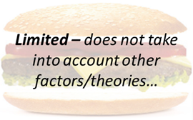
AO3
POINT - However, one criticism of the cognitive approach is that it does not take into account other factors, for example…
EVIDENCE - What factors does the cognitive approach ignore?
EXPLAIN - This matters because…

Slide 12
AO3 – this final burger is up to you, there is a hint!
POINT –
EVIDENCE –
EXPLAIN -

Slide 13
Please bring all of your notes to the next lesson
See you soon
Miss Fox

